Slide 1
التقويم الميلادي و الهجري

Slide 2
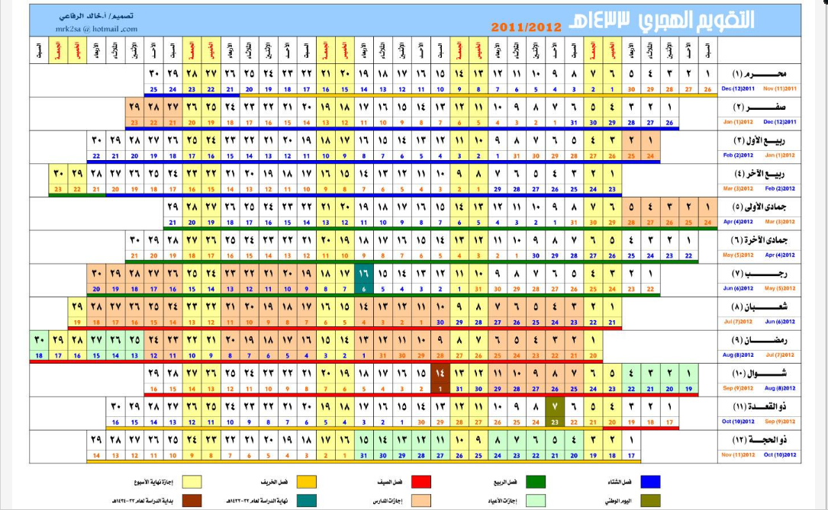
Notes:
http://csep10.phys.utk.edu/astr161/lect/time/calendars.html

Slide 3
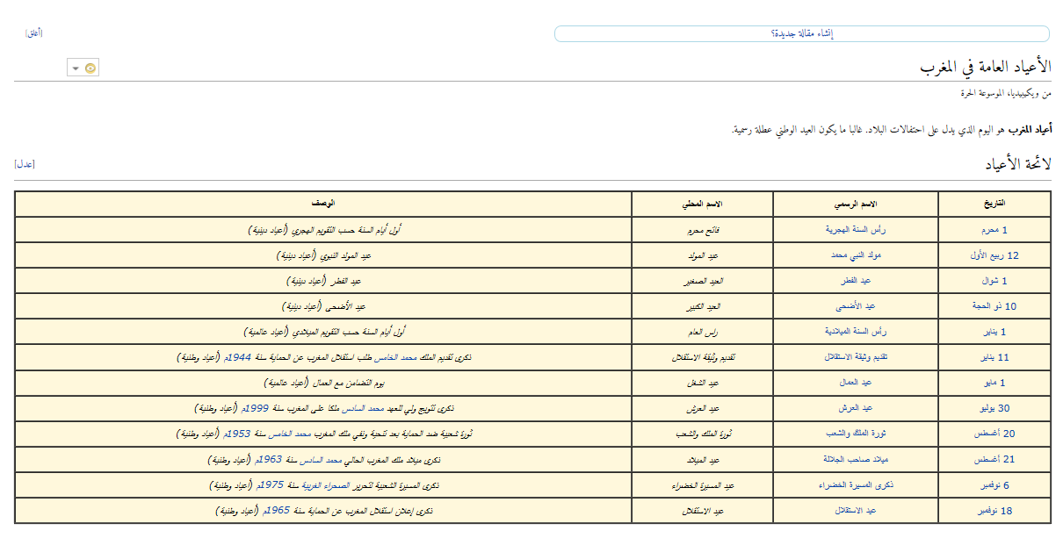
الأعياد في المغرب

Slide 4
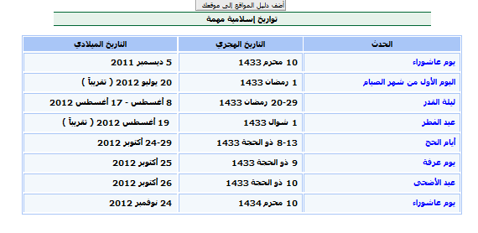

Slide 5
Lunar and Solar calendars
There are two basic sources for calendars presently in use: the monthly motion of the Moon (Lunar calendars) and the yearly motion of the Sun (Solar Calendars). The difficulty with Lunar calendars is that the seasons are linked with the Sun, not the Moon. Thus, Lunar calendars require elaborate adjustments or translations to relate to the seasons. That calendars correlate with seasons is now primarily a matter of convenience, but in more ancient cultures keeping track of the seasons was serious business: it could be a matter of survival to know things like the proper time to plant to ensure a bountiful harvest.

Slide 6
The Roman Lunar Calendar
Our present calendar (called the Gregorian Calendar) is a basically solar calendar that grew from what was originally a Lunar calendar used by the Romans. The original calendar contained 10 months of length 29 or 30 days. This was later modified to a 12 month calendar, but 12 months of average length 29.5 days gives only 354 days in the year, whereas the orbital period of the Earth is 365.242199 days. Thus, at the end of each year this calendar was 11 days out of step with the seasons and at the end of 3 years it was almost a month out of step. This was initially corrected in an arbitrary way by adding 13th months, but this was used for various political purposes and soon threw the calendar into severe confusion.

Slide 7
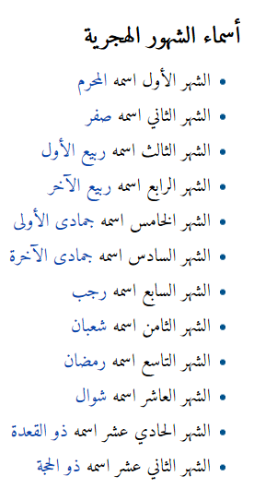

Slide 8
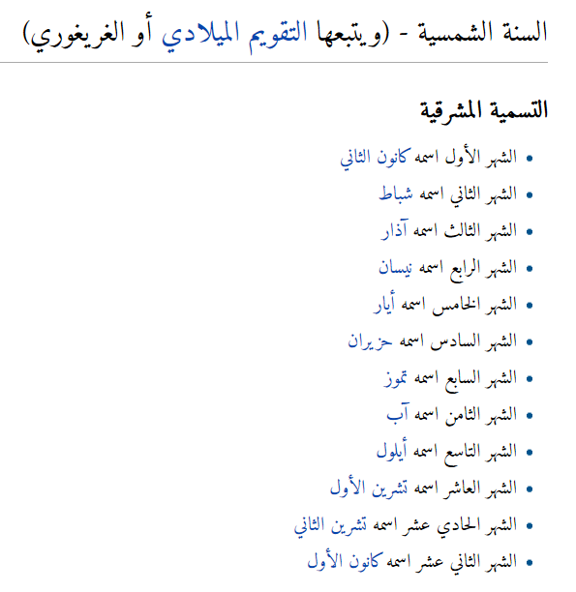

Slide 9
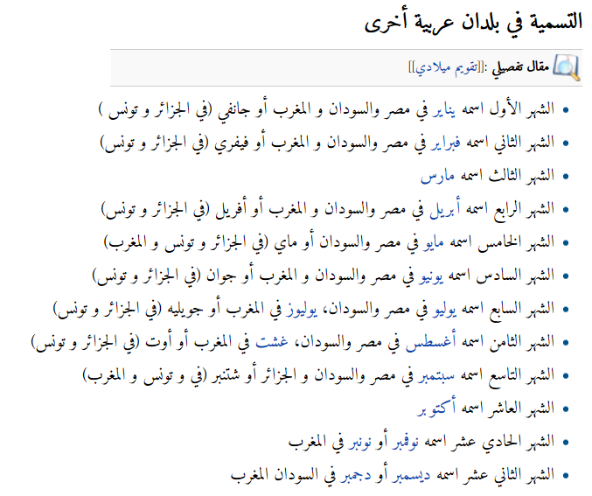

Slide 10
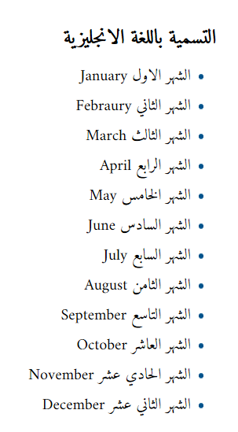

Slide 11
